Slide 1
Safety Concept for Nuclear Power

Slide 2
Traınıng Objectıves
TO-1 Upon completion of this course a trainee will be able to explain the safety concept for all life stages of nuclear power installations and apply his knowledge in practice.
EO-1 Definition of nuclear safety
EO-2 Safety goal
EO-3 Safety principles
EO-4 Defense – in – depth
EO-5 Safety standards
EO-6 Safety requirements (design-construction-commissioning-operation-decommissioning-site rehabilitation)
EO-7 Evaluation of safety
EO-8 Maintaining and improvements of safety

Slide 3
Definition of safety

Slide 4
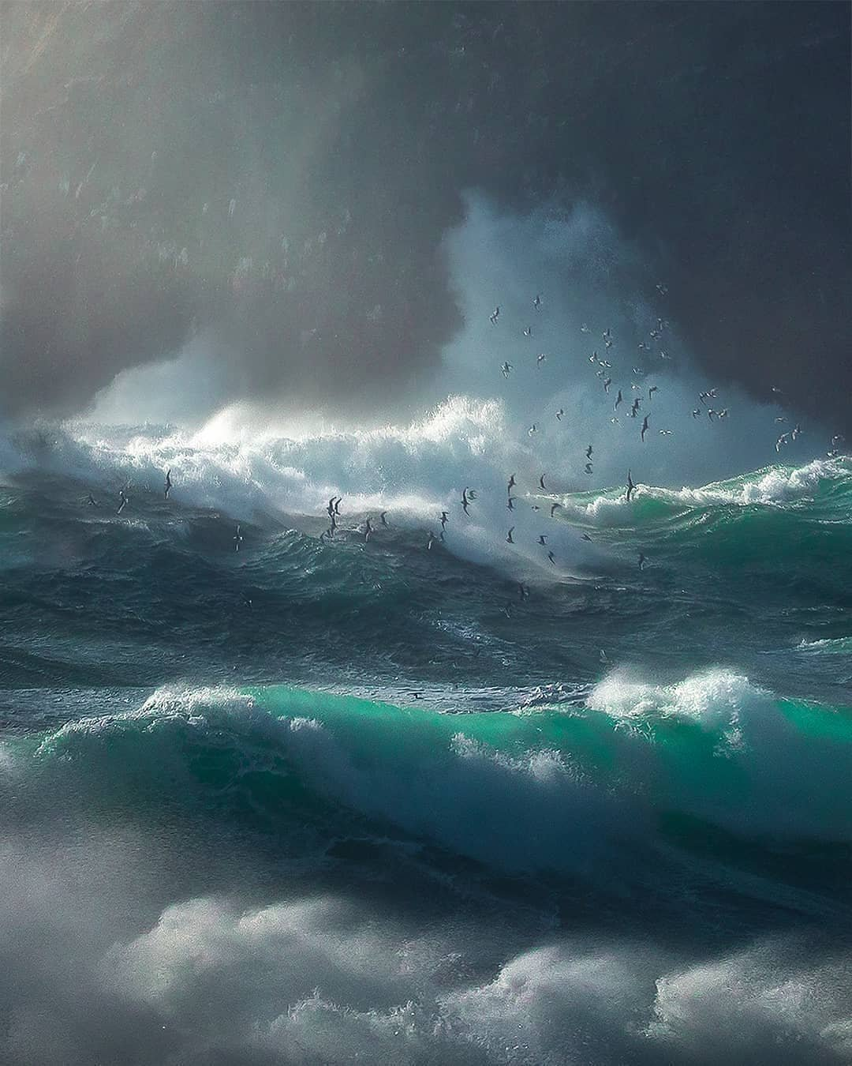
Modern world produces many hazards
Hazards it are the attribute of nature
Industry produces additional – human made hazards
Nuclear power industry produces specific hazards - radiation

Slide 5
Life "without dangers" is an incorrect idealization, and the term "safety" should be understood as a system of measures to protect against dangers as much as possible, as the ability to manage dangers, the ability to prevent dangerous situations, as well as mitigate their consequences.
For potentially hazardous facilities, such as nuclear power plants, the term “safe” can be interpreted as “an acceptable level of hazard”

Slide 6
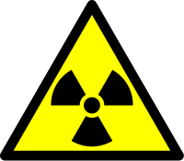
Main and most significant hazard of NPP operation – is radiation
The term “safety” includes the safety of nuclear installations, radiation safety, the safety of radioactive waste management and the safety of transport of radioactive material, but does not include non - radiation safety aspects

Slide 7
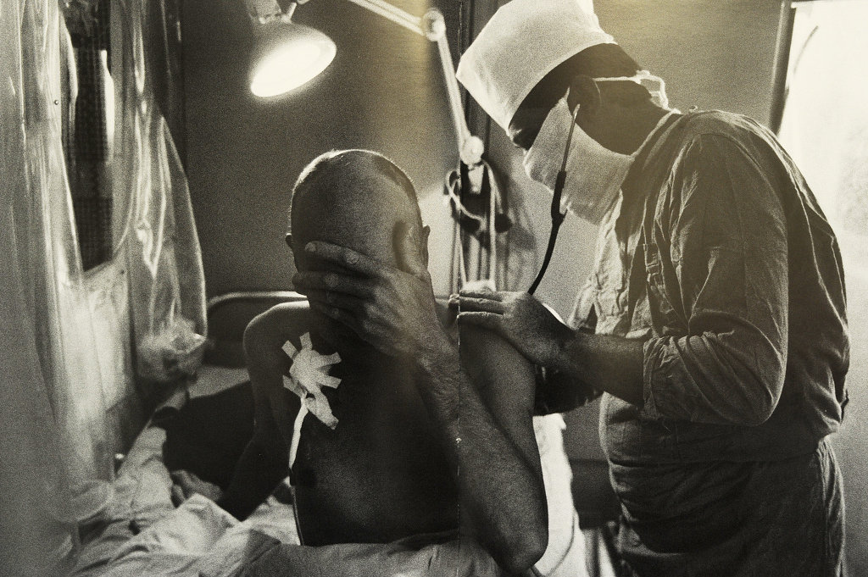
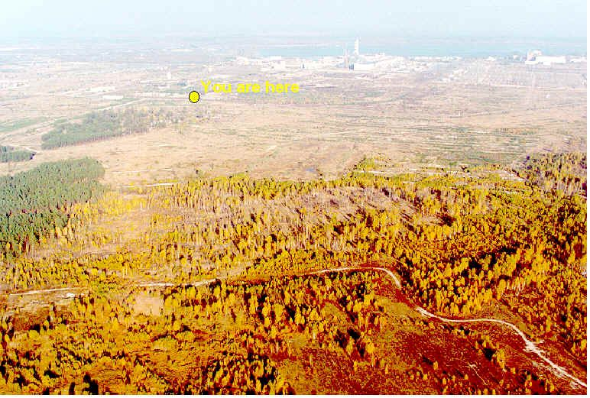
Radiation Damage
The main type of damage specific to the NPP is the loss of health of personnel and the population due to the radiation effect of radioactive emissions of substances that have spread on the NPP site or beyond during severe accidents.

Slide 8
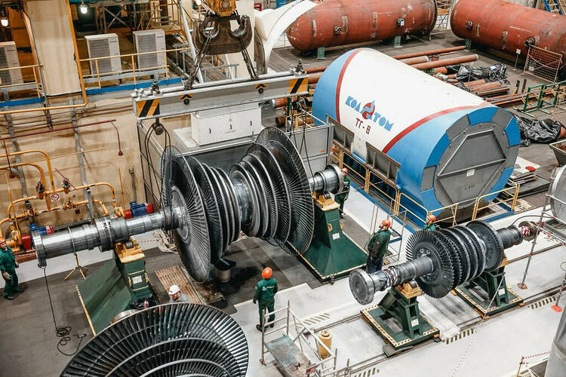
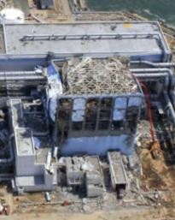
Collateral Damage
1 day of Unit shutdown – more then
1 000 000 €
collateral damage are also significant - economic losses from the destruction of technical systems and structures, damage from the loss of a difficult – to - renew source of energy supply, losses from pollution of territories, water systems, forests. Ecological damage is very important - irreversible changes in ecosystems, loss of valuable species of wildlife due to changes in immune systems, loss of species diversity.
Fukushima accident –
more then
500 000 000 000 €

