Slide 1
Operational Experience Feedback
Regulatory approach
Prepared by
D.Vorontsov

Slide 2
Purposes
Purposes:
To describe the main objectives of OEF
With regards of importance of OEF findings to support of appropriate safety level and importance of OEF in terms of safety culture
Operational event investigation and analysis
Investigation processes including direct and root causes analysis, event categorization, trend analyses, corrective actions development and implementation
International experiences. IAEA approach (IRS, INES), Clearinghouse, Russian and Ukraine practices
OEF system elements
PI development and implementing (Utility and RB practices)
Reports on current safety level of NPP

Slide 3
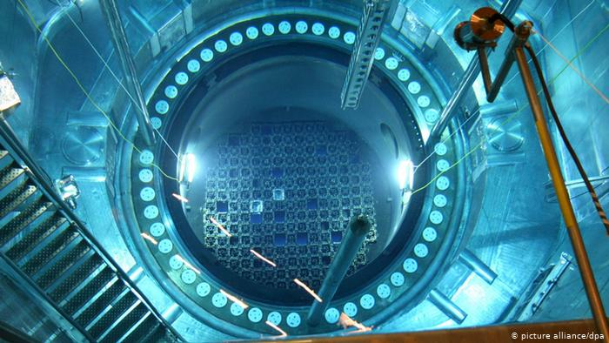
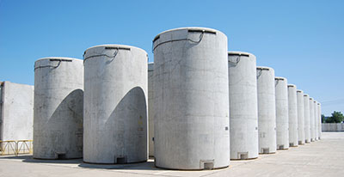
Purposes
All organizations with responsibilities for safety should foster mutual understanding and respect through honest and open communication on operating experience as part of a strong safety culture (as indicated by Requirement 12 of GSR Part 2).
This communication should include reporting any deficiencies with potential adverse effects on safety even if they are not covered by formal reporting requirements.
The regulatory body shall make arrangements for analysis to be carried out to identify lessons to be learned from operating experience and regulatory experience, including experience in other States, and for the dissemination of the lessons learned and for their use by authorized parties, the regulatory body and other relevant authorities.” GGSR part 1

Slide 4
Operating experience feedback
Every regulatory body with safety related responsibilities should establish and implement an effective operating experience programme. A graded approach should be used to apply the programme in a manner commensurate with the risks associated with the activities at the regulated installation(s).
Regulations to establish and maintain operating experience program and the such program are in the place at operating organization.

